Slide 1
Data Science Research Trends
Yogesh Kulkarni

Slide 2
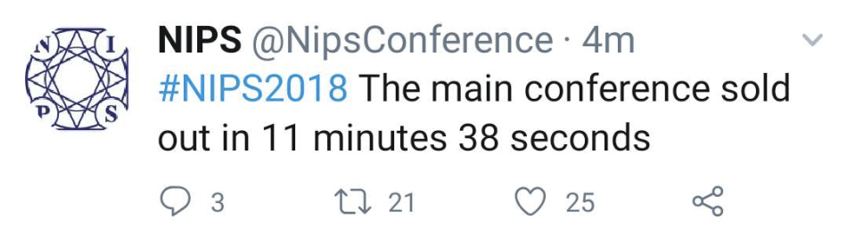
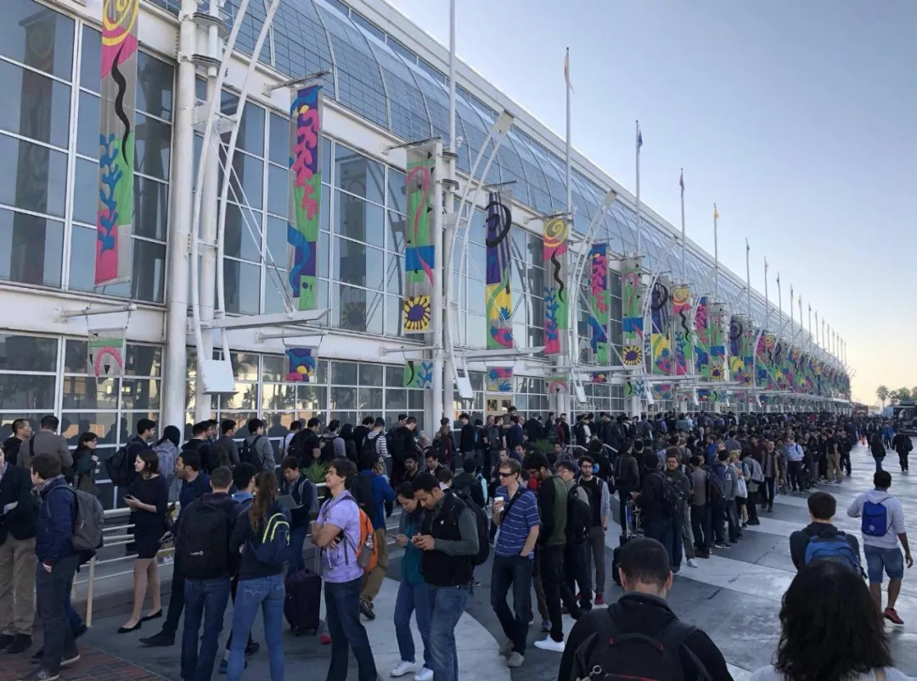
AI Conference or Pop Concert?
(Ref: NIPS Tickets Sell Out in Less Than 12 Minutes - Synced)

Slide 3
History of Deep Learning Ideas
1943: Neural networks (Walter Pitts and Warren McCulloch)
1957-62: Perceptron (Frank Rosenblatt)
1970-86: Backpropagation, RBM, RNN
1979-98: CNN, MNIST, LSTM, Bidirectional RNN
2006: “Deep Learning”, DBN
2009: ImageNet + AlexNet
2014: GANs
2016-17: AlphaGo, AlphaZero
2017: 2017-19: Transformers

Slide 4
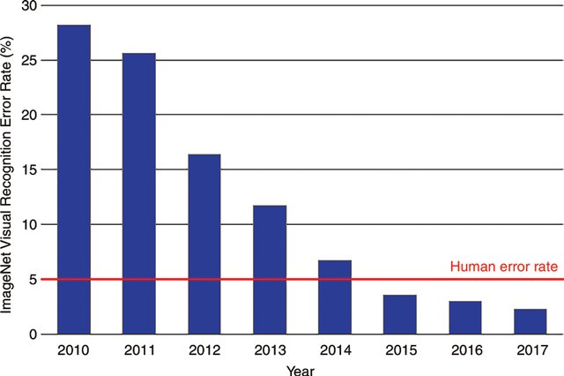
In recent past…Imagenet..

Slide 5
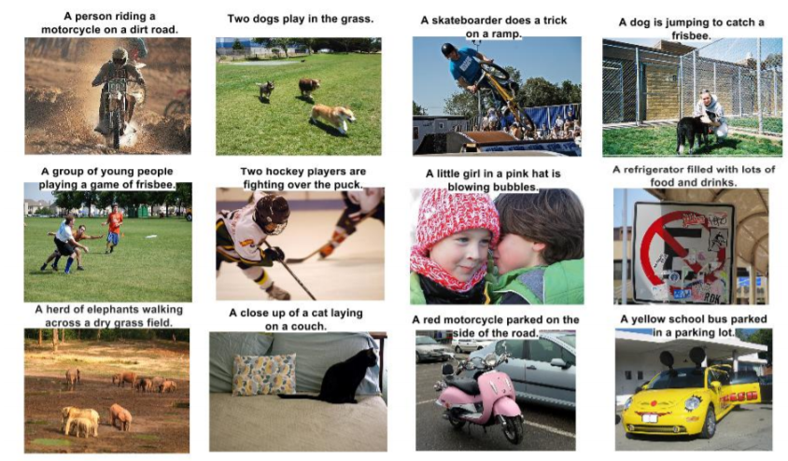
Image Captioning Challenge

Slide 6
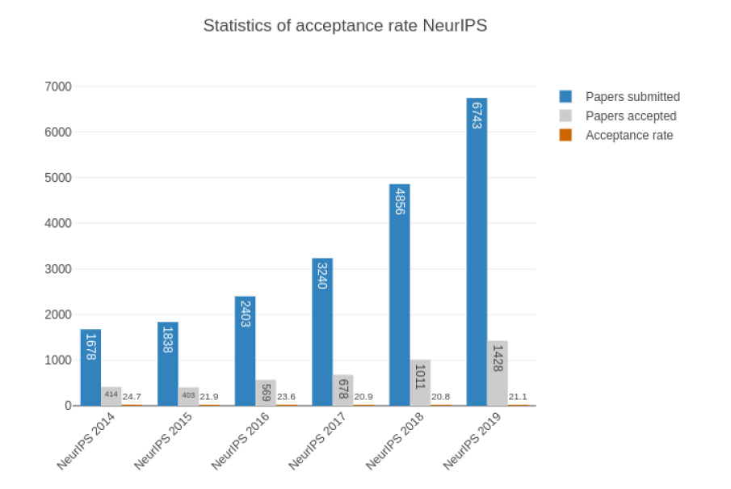
Research Community is growing

Slide 7
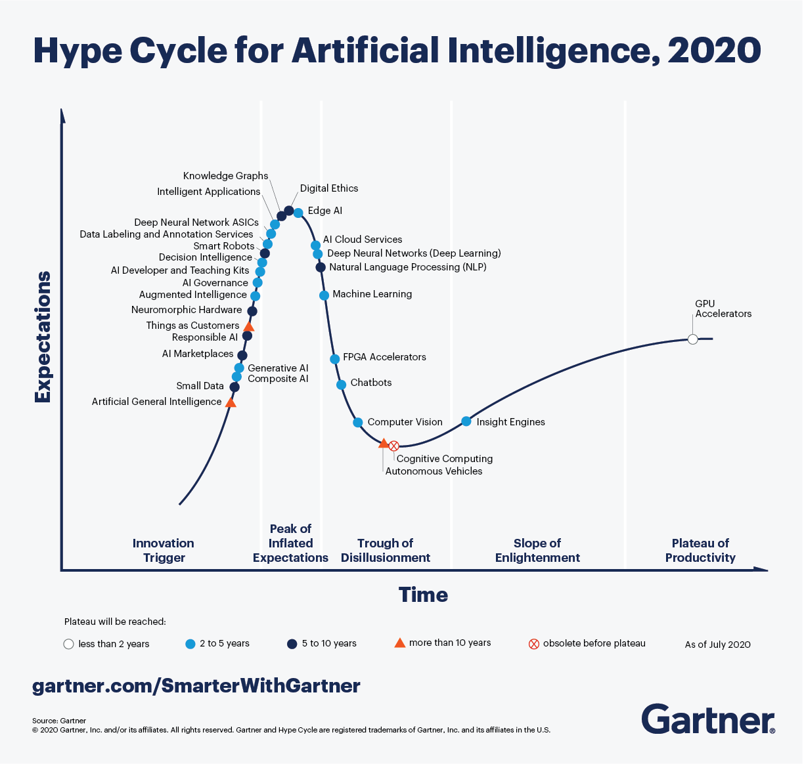
Gartner Predicts

Slide 8
On the Rise
Artificial General Intelligence
Small Data
Generative AI
Responsible AI
Augmented Intelligence
AI Governance

Slide 9
At the Peak
Smart Robots
Data Labeling and Annotation Services
Knowledge Graphs
Edge AI
AI Cloud Services
Deep Neural Networks (Deep Learning)
Natural Language Processing (NLP)

Slide 10
Sliding Into the Trough
Machine Learning
Chatbots
Computer Vision
Autonomous Vehicles
Cognitive Computing

Slide 11
Hope for the future
Active learning and life-long learning
Multi-modal and multi-task learning
Open-domain conversation
Applications: medical, autonomous vehicles
Algorithmic ethics
Robotics

Slide 12
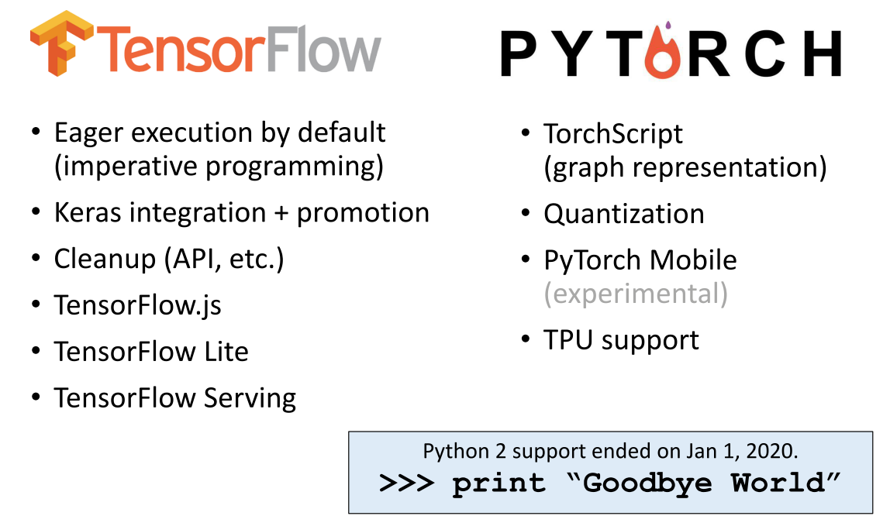
On the ground

Slide 13
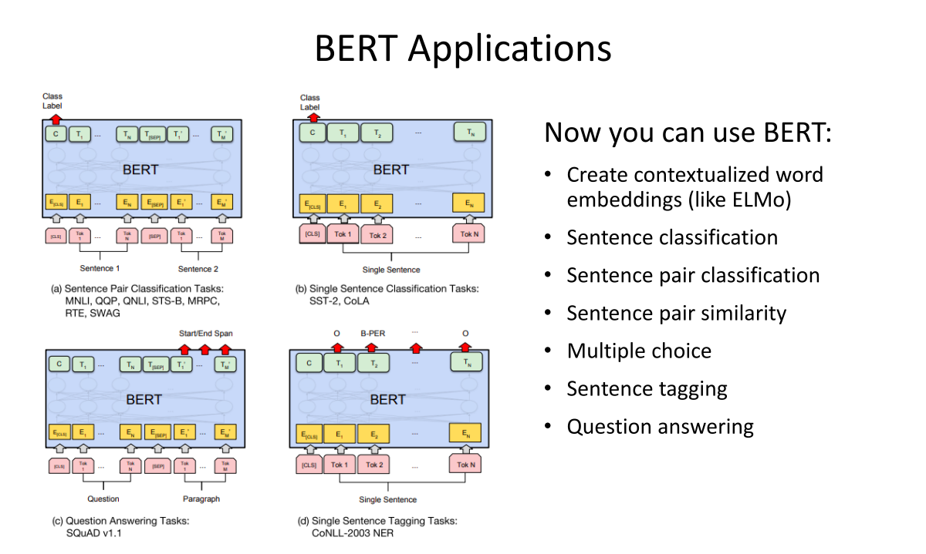
NLP

Slide 14
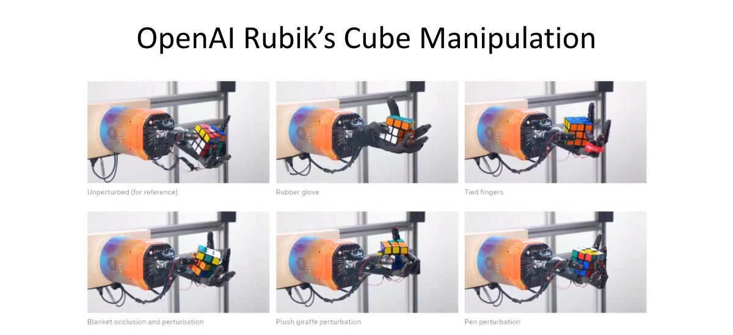
Reinforcement Learning

Slide 15
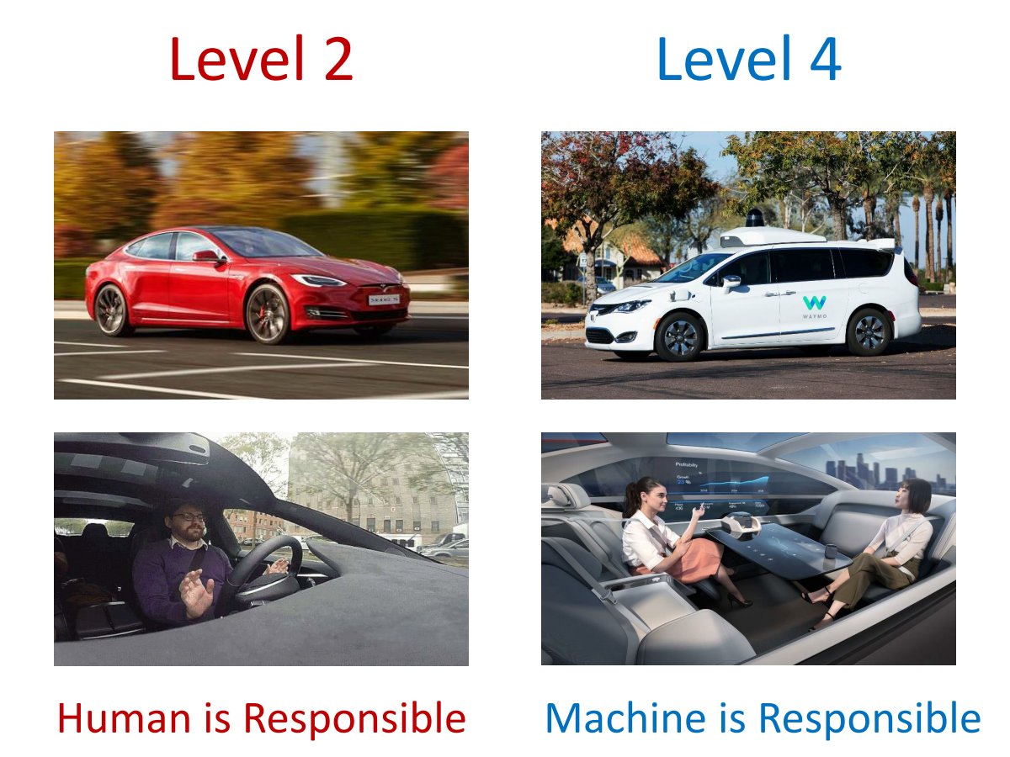
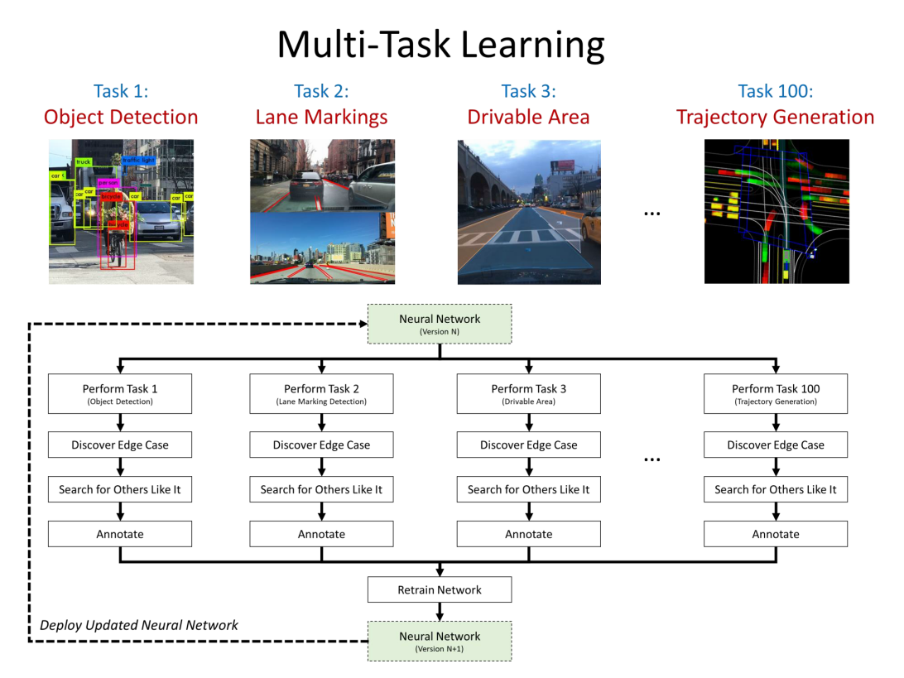
Autonomous Cars

Slide 16
Where to look?
Papers with Code:
State of the Art, domain wise
Trending, Latest, Top rated ,
Look for stars
Get code!!
Two Minute Papers Youtube

Slide 17
References
Pieter Abbeel: Recent Advances and Trends in Artificial Intelligence | Keynote | ODSC East 2019
Deep Learning: State of the Art (2020) – Lex Fridman, MIT

